Slide 1


Fraudulent Job Listings
Building a predictive model

Slide 2

Our Presentation
1
2
3
Data Overview
Building our Model
Model Accuracy
Notes:
General flow of presentation:
Introductions → Data Overview → Cleaning Data → Key Highlights from Analysis → Preparing Data for Modeling → Model Building/Testing/Reiteration → Model Accuracy & What our Model Missed → Overall Conclusions

Slide 3
Applications
Online Job Portals (e.g., LinkedIn, Naukri , etc)
Recruitment Agencies
Corporate HR Systems
Government and Employment Services
Mobile Apps for Job Seekers
Notes:
General flow of presentation:
Introductions → Data Overview → Cleaning Data → Key Highlights from Analysis → Preparing Data for Modeling → Model Building/Testing/Reiteration → Model Accuracy & What our Model Missed → Overall Conclusions

Slide 4
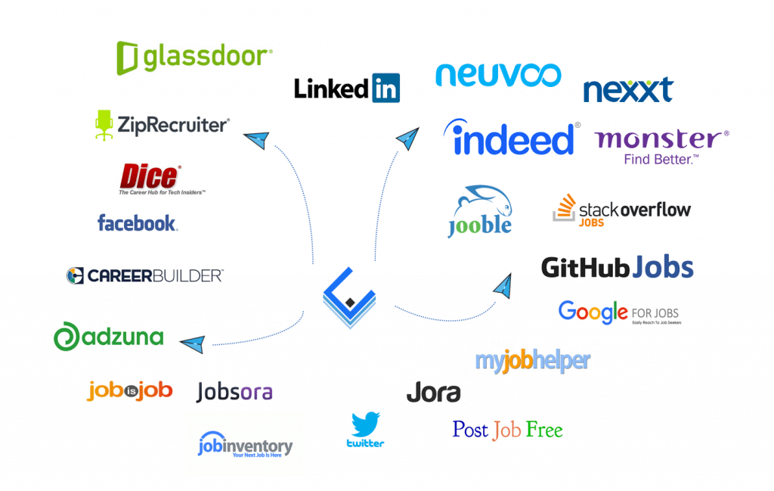

Data Overview
17,800 job listings
(4.84% of listings are fake)
18 Original Columns
Job Title/Description
Industry/Department
Required Experience/Education
Employment Type
Listing Characteristics
Notes:
Our dataset included just under 18,000 job listings, of which around 5 percent were known to be fraudulent. We will discuss how we handled this column in our data later on in the presentation.
Our data originally had 18 columns containing the basic information expected of standard job postings. Additional columns used in building our predictive model will be discussed when relevant.

Slide 5
Missing Values
Column | Percent NaN
Location | 2%
Department | 64.5%
Salary Range | 84%
Company Profile | 18.5%
Requirements | 15%
Benefits | 40%
Employment Type | 19%
Required Experience | 39%
Required Education | 45%
Industry | 27%
Function | 36%
NaN → “Not Provided”
Notes:
So instead of dropping NaN values, focusing on these 7 columns, NaN and other similar values representing a lack of information were replaced with “Not Provided”. This was done because missing salary or requirements or even department information on a job listings is universally considered a red flag so this approach ensured our model was given the best information to train on.
However, we had to take a different approach with the Salary Range column

Slide 6


Data Highlights
Industries & Departments
Education & Experience
What we do?
Salary
Notes:
TRANSITION SLIDE FOR DATA ANALYSIS HIGHLIGHT
Pull out some highlights for this slide

Slide 7
Preprocessing
Raw data is noisy, incomplete, and inconsistent
Missing or irrelevant values
What we do?
Transform categorical features
Notes:
TRANSITION SLIDE FOR DATA ANALYSIS HIGHLIGHT
Pull out some highlights for this slide

Slide 8
Required Education
Real Job Listings
Not Provided - 45%
Bachelor’s Degree - 30%
High School or Equivalent - 11%
Unspecified - 8%
Master’s Degree - 2%
Associate Degree - 1.5%
Certification - 0.89%
All over required education < 1%
Fraudulent Job Listings
Not Provided - 68%
High School or Equivalent - 20%
Bachelor’s Degree - 11.5%
Unspecified - 7%
Master’s Degree - 3.5%
High School Coursework - 2%
Certification - 2%
All other required education < 1%
Notes:
Maybe for this and the next slide, we could combine them to be one slide with a table, one for real job postings and one for fake job postings?

Slide 9
Required Experience
Real Job Listings
Not Provided - 39%
Mid-Senior Level - 22%
Entry Level - 15%
Associate - 13%
Not Applicable - 6%
Director - 2%
Internship - 2%
Executive - 0.77%
Fraudulent Job Listings
Not Provided - 50%
Entry Level - 21%
Mid-Senior Level - 13%
Not Applicable - 7%
Associate - 5%
Director - 2%
Executive- 1%
Internship- 1%
Notes:
Maybe for this and the next slide, we could combine them to be one slide with a table, one for real job postings and one for fake job postings?

Slide 10
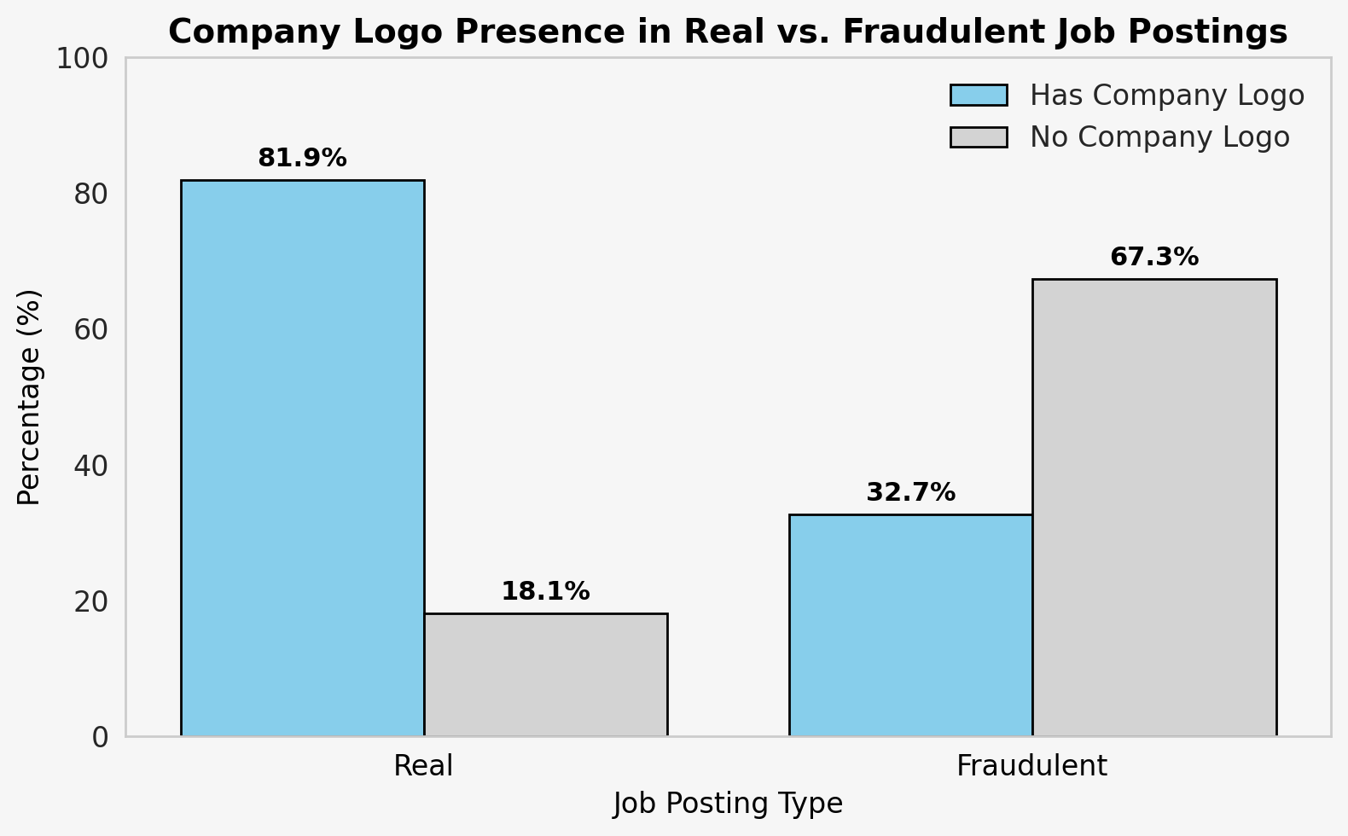

Slide 11
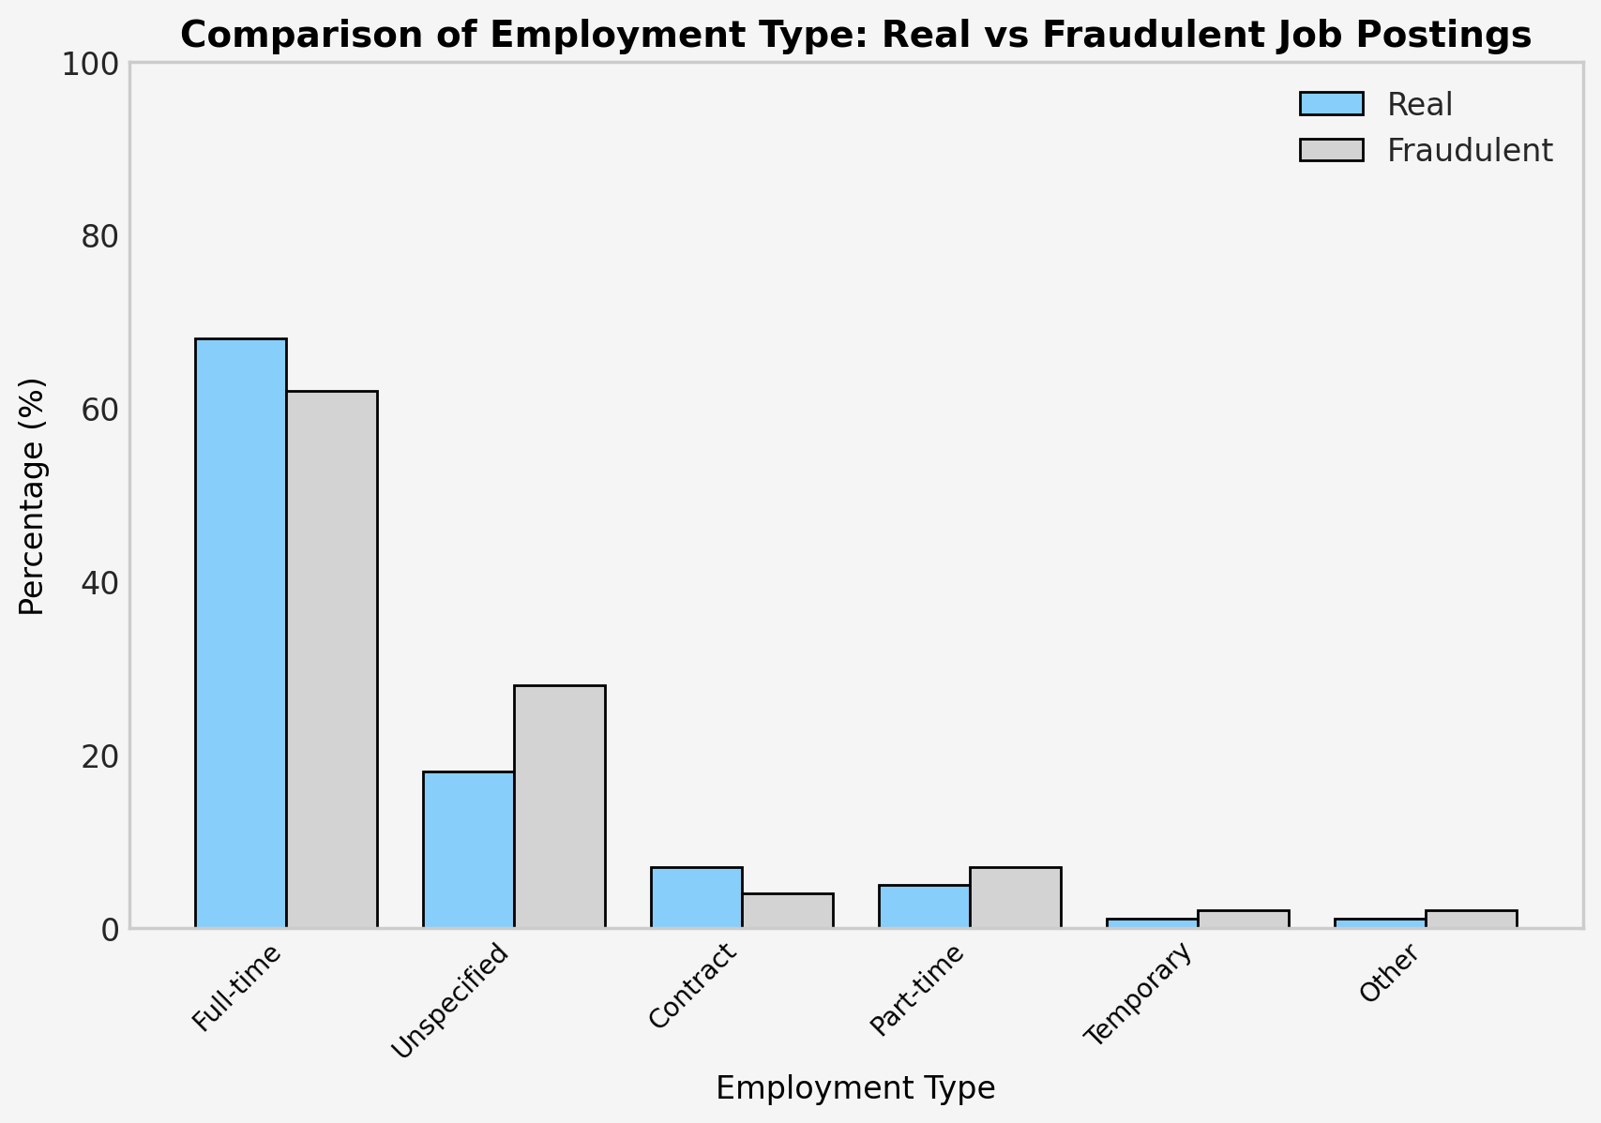

Slide 12

Data
Preparation
Data Modification
Textual Data → Numeric Values
Column | Change Process
Job Description | String Length
Education | Ordinal Encoding
Employment Type | Ordinal Encoding
Industry | One Hot Encoding
Department | One Hot Encoding
Salary | Difference in range
Notes:
Before begin with fitting and revising our model, it was imperative that we modify several columns so that they would be compatible with different sklearn models.
The first of these was simple, just taking the length of the job description of each row.
Both Required Education and Employment Type used Ordinal Encoder from the Preprocessing folder in SKLearn library. This was done because education follows a logical hierarchy and employment, while one is not necessarily better than the other, they do follow an order.
For the industry and department, we used One Hot Encoding to avoid unintentionally ranking departments/industry against each other and creating unintended bias in our model.

Slide 13
Feature Transformation & Encoding
Ordinal Encoding :
For ordered categories
Converts categorical variables with a clear order or ranking into integers.
['High School', 'Bachelor’s', 'Master’s', 'PhD'] → [1, 2, 3, 4]
One-Hot Encoding :
For unordered categories
Converts each text into a separate binary (0 or 1) column.
['IT', 'Healthcare', 'Finance'] → [1, 0, 0], [0, 1, 0], [0, 0, 1]
Notes:
Before begin with fitting and revising our model, it was imperative that we modify several columns so that they would be compatible with different sklearn models.
The first of these was simple, just taking the length of the job description of each row.
Both Required Education and Employment Type used Ordinal Encoder from the Preprocessing folder in SKLearn library. This was done because education follows a logical hierarchy and employment, while one is not necessarily better than the other, they do follow an order.
For the industry and department, we used One Hot Encoding to avoid unintentionally ranking departments/industry against each other and creating unintended bias in our model.

Slide 14
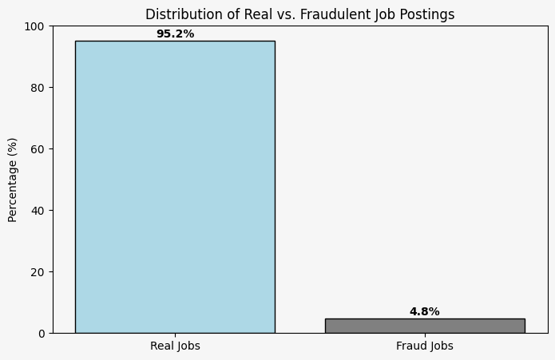
Unbalanced Dataset!
Notes:
Our model did not have a balanced number of columns, which resultently caused inconsistency behind real job posting accuracy

Slide 15
Balancing the Dataset to Improve Model Fairness
Hybrid Sampling = Undersampling real jobs + Oversampling fake jobs.
This approach avoids:
Too much data loss (pure undersampling).
Too much duplication (pure oversampling).
Balanced data enables fairer and more effective model training.
Notes:
Our model did not have a balanced number of columns, which resultently caused inconsistency behind real job posting accuracy

Slide 16
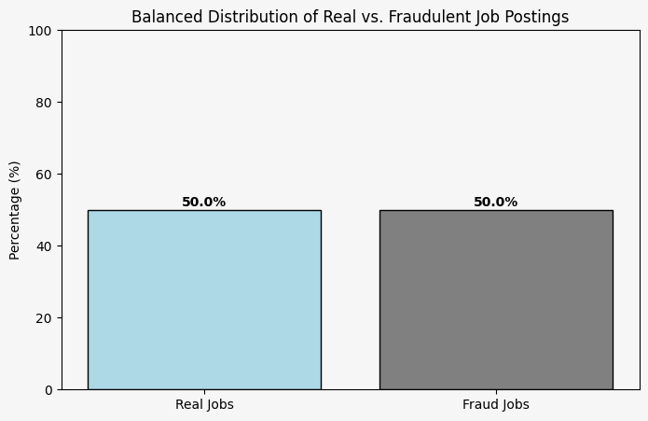
Balancing the scales
Notes:
This is where we balanced our dataset in order to move on with our predictive model

Slide 17
Initial Model Creation
Logistic Regression
Accuracy: 52.8%
Threshold >= 0.3:
Department Not Provided (0.329)
Employment Encoded (0.314)
Threshold >= 0.1:
Department Not Provided (0.33)
Job Description Length (0.240)
Employment (0.31)
Education (0.15)
Industry Not Provided (0.219)
Threshold >= 0.05:
Department Engineering (0.07)
Department Not Provided (0.33)
Job Description Length (0.24)
Has Company Logo (0.06)
Has Questions (0.07)
Employment (0.31)
Education (0.15)
Industry Finance (0.06)
Industry Not Provided (0.22)
After carrying out correlation analysis: Validation accuracy (74.4%)
Notes:
The first steps in building our model was splitting our data up into our train, validation, and test sets and ensuring no NaN values were included in input columns. We could
However the meat and potatoes of model building was starting out with Logistic Regression as our model. Now at first glance, this model was doing pretty well in predicting when a job listing was genuine versus fraudulent. We tested our model model on the validation set at three different coefficient thresholds to determine if the accuracy shifted and one threshold was better than the other. Across all three of these coefficient thresholds, our accuracy continued to hover around 95%
However, we all felt that this was a little too good to be true. So we decided to run a confusion matrix

Slide 18
Multicollinearity
Unexpected Issue: Multicollinearity
* Many columns had similar accuracy scores
* Calculated the Variance Inflation Factor (VIF) to identify these features
VIF analysis revealed that some features were too similar, causing collinearity in Industry and Department columns.
Cause: An extra reference column in one-hot encoding created a dummy variable trap.

Slide 19
Logistic Regression
1
Balance Data Sets:
50% Accuracy for Model Prediction
Similar Accuracy Score
2
VIF:
VIF analysis revealed collinearity in Industry and Department due to an extra reference column in one-hot encoding (dummy variable trap).
3
Utilizing PCA:
Utilizing Principal Components to increase overall model accuracy, but it didn’t help much
V3
4
Removing Highly Correlated Columns:
Eliminated the Standardized Departments to increase overall accuracy
Increased overall job posting Accuracy to 75.3%
Notes:
So what are our next steps for building an accurate model? The first step was to create a balanced data set with an equal number of fraudulent and genuine jobs. The unfortunate draw back of this that we aren’t utilizing a large chunk of our dataset. Recall that our original dataset included 17,880 listings. In order to maximize our utilization of our dataset, we implemented warm start, which essentially allows our model to retain the information it gained from previous predictions when making subsequent predictions.
With these two changes, we will retrain and validate our model, utilizing a confusion matrix once again in order to ensure that our model it’s just super super confident in predicting all of the jobs are fake.
We will see a decrease in our accuracy from our previous 95% using this altered approach but we’d rather see a “worse” model that’s fairly confident it’s making the right predictions and have it actually make correct predictions than a model that’s certain it’s making the correct prediction and getting it wrong every time.

Slide 20
XGBoost Model
Version A: Dropping Standardized Industry
Version B: Dropping Standardized Department
Validation Accuracy: 0.8923
Accuracy: 0.8750
precision recall f1-score support
0 0.94 0.85 0.89 265
1 0.85 0.94 0.90 255
precision recall f1-score support
0 0.92 0.83 0.87 265
1 0.84 0.92 0.88 255
On dropping Industry it gave better accuracy
Test Accuracy: 0.8808
Notes:
The first steps in building our model was splitting our data up into our train, validation, and test sets and ensuring no NaN values were included in input columns. We could
However the meat and potatoes of model building was starting out with Logistic Regression as our model. Now at first glance, this model was doing pretty well in predicting when a job listing was genuine versus fraudulent. We tested our model model on the validation set at three different coefficient thresholds to determine if the accuracy shifted and one threshold was better than the other. Across all three of these coefficient thresholds, our accuracy continued to hover around 95%
However, we all felt that this was a little too good to be true. So we decided to run a confusion matrix

Slide 21
XGBoost Model
Using Scree plot analysis we got the optimal number of attributes as 34
'Standardized_Department_Project Management', 'Standardized_Department_Hospitality & Food Services', 'Standardized_Department_Product Management & Development', 'Standardized_Department_Government & Public Sector', 'Standardized_Department_Human Resources', 'Standardized_Department_Operations', 'Standardized_Department_Logistics & Supply Chain', 'Standardized_Department_Administrative', 'Standardized_Department_Education & Training', 'Standardized_Department_Customer Service', 'Standardized_Department_Research & Development', 'Standardized_Department_Retail & Consumer', 'Standardized_Department_Finance & Accounting', 'Standardized_Department_Healthcare', 'Standardized_Department_Quality Assurance & Testing', 'Standardized_Department_IT', 'Standardized_Department_Engineering', 'Standardized_Department_Technology', 'Standardized_Department_Creative & Design', 'Standardized_Department_Legal & Compliance', 'Standardized_Department_Marketing', 'Standardized_Department_Media & Communications', 'Standardized_Department_Business Consulting', 'employment_encoded', 'salary_diff', 'Standardized_Department_Manufacturing & Production', 'has_questions', 'has_company_logo', 'telecommuting', 'job_desc_length', 'education_encoded', 'Standardized_Department_Sales', 'experience_encoded', 'Standardized_Department_Not Provided'
Notes:
The first steps in building our model was splitting our data up into our train, validation, and test sets and ensuring no NaN values were included in input columns. We could
However the meat and potatoes of model building was starting out with Logistic Regression as our model. Now at first glance, this model was doing pretty well in predicting when a job listing was genuine versus fraudulent. We tested our model model on the validation set at three different coefficient thresholds to determine if the accuracy shifted and one threshold was better than the other. Across all three of these coefficient thresholds, our accuracy continued to hover around 95%
However, we all felt that this was a little too good to be true. So we decided to run a confusion matrix

Slide 22
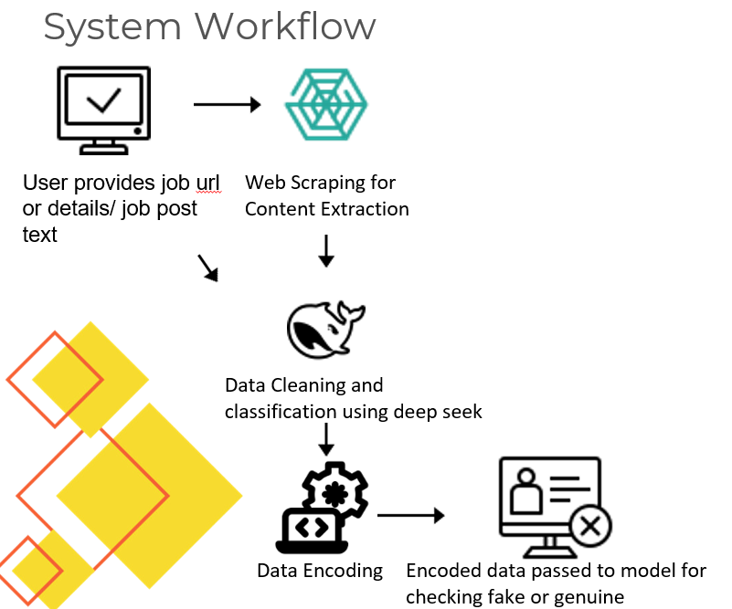
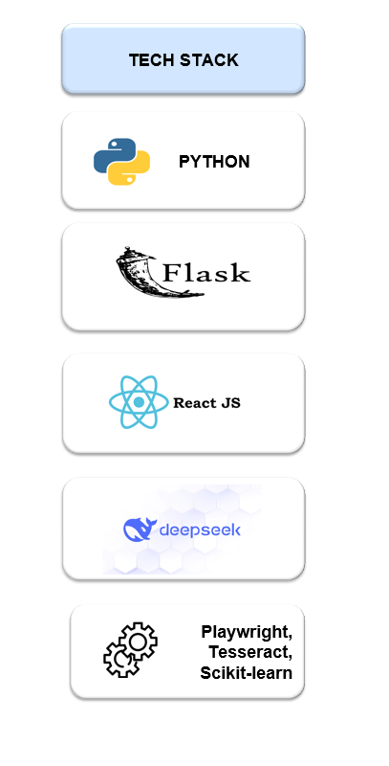
Integration with Flask app
Notes:
The first steps in building our model was splitting our data up into our train, validation, and test sets and ensuring no NaN values were included in input columns. We could
However the meat and potatoes of model building was starting out with Logistic Regression as our model. Now at first glance, this model was doing pretty well in predicting when a job listing was genuine versus fraudulent. We tested our model model on the validation set at three different coefficient thresholds to determine if the accuracy shifted and one threshold was better than the other. Across all three of these coefficient thresholds, our accuracy continued to hover around 95%
However, we all felt that this was a little too good to be true. So we decided to run a confusion matrix

Slide 23
Thankyou

